Slide 1
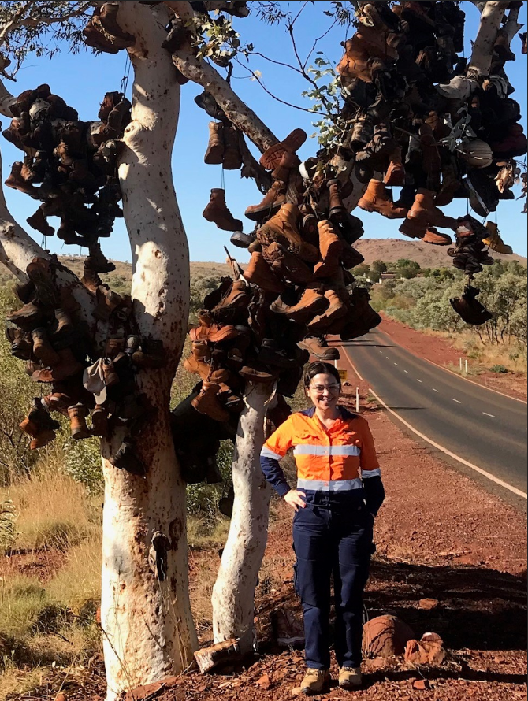
Sara Ghavanloo. Principal Process and Systems at BHP
Technology has always been a passion for me, so it wasn’t a surprise when my study led me down this pathway. What was a surprise though, was ending up in Maintenance and seeing just how much technology now plays a part.
I have an associates degree in Computer Science, and a Bachelor of Computer engineering, system design and analysis.
When I came to Australia I started studying my Masters in Environmental Engineering and Engineering Management at Griffith University and at the same time was lucky to get a job with BHP as the project control engineer, working across the Bowen Basin for de-bottlenecking projects. I was working and studying full time.
During the industry downturn I started working in oil and gas. Here I was working on projects and got to delve into the system design and analysis.
But for me, I always wanted to be back here. I had heard about the Maintenance Centre of Excellence (MCoE) and IROC centres at BHP. There was positions available at both, and I ended up starting in the MCoE in 2017.
I had never done a maintenance role before, but what I’m doing now in the Asset Management Process and Systems team, I just love.
None of my days are the same. I’ve learned a lot, and this position has pushed me out of my comfort zone because you’re dealing with such a broad stakeholder group.
I constantly push myself, and I’m so happy I took this opportunity to develop. I’m brining my technical knowledge for the design and build of systems for improvements.
It’s such a broad scope and all about building new systems to make life easier and safer for people.
Recently our team worked on a new improvement that saves time for supervisors on site, so they can get more time in the field developing their teams. It helps them increase safety, and it’s honestly something I’m so proud of.
“Being in this role gave me the opportunity to have direct connection with all maintenance and non-maintenance users to see how technology can impact their life!

